Slide 1
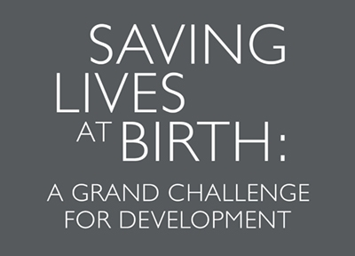


Filling, Sealing and Providing the Pratt Pouch
A Training for Pharmacists and Pharmacist’s Assistants

Slide 2
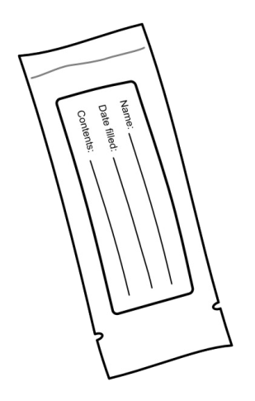
Today’s Agenda
Welcome to workshop
The PMTCT challenge: Global and national/local
Introduction to Pratt Pouch
Skills practice: Filling and sealing the pouch
Skills practice: Testing the pouch seal
Skills practice: Providing the pouch

Slide 3
The PMTCT Challenge
1.5 million pregnant women in low/middle-income countries living with HIV (2010)
Over 400,000 new HIV infections in children annually
90% from MTCT
Without intervention, 35% risk of transmitting HIV during pregnancy, labour & delivery or breastfeeding
non-breastfeeding: 15-30%
breastfeeding: 20-45%
HIV/AIDS mortality rates if untreated: 30% by age 1, 50% by age 2, and 60% by age 3

Slide 4
PMTCT: 4-Pronged Strategy
HIV testing system in the facility
Antiretroviral (ARV) prophylaxis for mother and infant
Counseling on maternal nutrition and infant feeding for HIV-positive mothers
Family planning counseling and services

Slide 5
ARV Prophylaxis for Infant
Can reduce risk of MTCT by 75%
Infants born to women living with HIV who received ARV prophylaxis (2011):
Sub-Saharan Africa: 43%
Eastern and Southern Africa=55%
Western and Central Africa=14%

Slide 6
WHO PMTCT Protocol (2012)
Goal: virtually eliminating new pediatric HIV infections, now considered to be realistic
Key approach: short-term ARV prophylaxis to prevent MTCT during pregnancy, delivery and breastfeeding for HIV-infected women not in need of on-going treatment
Can reduce MTCT risk to 5% or lower in those breastfeeding

Slide 7
Global PMTCT

Slide 8
History of ARVs for PMTCT
Single dose NVP for mother and infant
AZT for mother during pregnancy and NVP or AZT for infant for 7 days
2010 – earlier start, triple ARVs and continuation during breastfeeding improves outcomes – Option A

Slide 9
WHO Programmatic Update on PMTCT – April 2012
Update to WHO’s 2010 PMTCT Guidance
Single universal regimen to treat HIV+ woman and prevent PMTCT
Simplify recommendations for infant ARV
Avoid stopping and starting – public demand for HIV+ women to stay on treatment

Slide 10
Countdown to Zero - 2015
UNAIDS strategy – AIDS free generation
Elimination of all new pediatric HIV infections by 2015
Reduce the # of HIV related
maternal deaths by 50%

Slide 11
UNAIDS estimates - 2011:
PMTCT global coverage of 57% of HIV+ women with ARVs
30% of those who were “eligible” by CD4 counts were on ARVs
330,000 infants globally were born with HIV

Slide 12
How is Option B+ different than previous PMTCT regimens?
WHO, 2012

Slide 13
Other factors influencing this movement:
Decreasing cost of ARVs
Accumulated safety data of Efavirenz in pregnancy
Removes need for CD4 prior to starting ARVs – pregnant women get started on treatment faster
Shift initiation out further in primary care and community MCH services sites
SIMPLE message – start ARV and stay on for life

Slide 14
Option B+

Slide 15
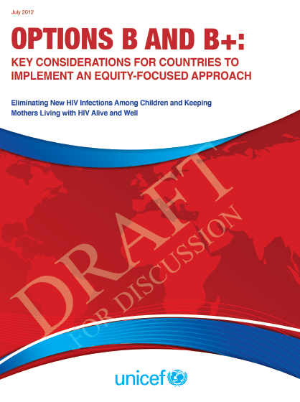
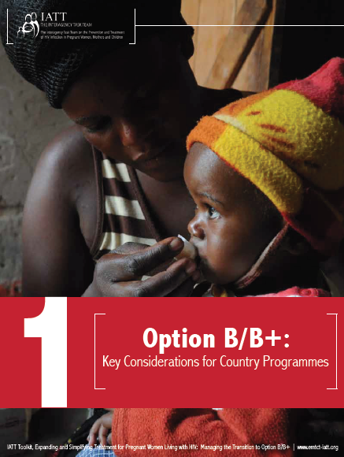

Slide 16
Advantages of Option B+ for families:
Reduced vertical transmission
Reduced maternal mortality
Simplified regimen and no need for CD4 prior to initiating ARV
Health benefits for women of earlier treatment
Continuous prevention for discordant couples – reduced horizontal transmission
Extended MTCT – future pregnancies

Slide 17
Advantages of Option B+ for countries
Simplified procurement of ARVs – stocking, forecasting, provider training for use
Combine guidelines for ART and PMTCT
Improved capability to care for and follow for mom/baby pairs
Simplified monitoring and evaluation
Increased acceptability of moving towards Treatment as Prevention

Slide 18
Zambia PMTCT Protocol

Slide 19
Local PMTCT Protocol
Mother:
HIV uninfected women will be tested every 3 months for the duration of pregnancy through the breastfeeding period.
HIV infected women with CD4>350 begin AZT prophylaxis at 14 weeks gestational age.
HIV-infected pregnant women with CD4 ≤ 350 or WHO Stage III/IV begin HAART as soon as possible, regardless of gestational age.
All HIV-infected pregnant women will receive cotrimoxazole prophylaxis after the first trimester through 6 weeks post-delivery regardless of CD4 count.
Infant:
HIV exposed infants whose mothers are on HAART receive NVP prophylaxis daily from birth until 6 weeks of age.
HIV exposed infants whose mothers are not on HAART and
Breastfeeding: will receive NVP prophylaxis daily from birth until one week after cessation of breastfeeding.
Non-breastfeeding: will receive NVP prophylaxis daily from birth until 6 weeks of age.

Slide 20
Zambia PMTCT Protocol (Option B+) await new guidance
Mother:
Triple ARVs starting as soon as diagnosed, continued for life
Infant:
Daily NVP from birth through age 4- 6 weeks regardless of infant feeding method

Slide 21
PMTCT and Homebirths
Infant must receive NVP within 6-12 hrs after birth
Majority of babies in Africa born at home (18M/year), timely access to NVP difficult
Distributing premeasured doses in advance, during antenatal care, problematic:
Cost of development/limited market
Needs to be liquid
Limited shelf lives of syringes, cups, other containers

Slide 22
Pratt Pouch

Slide 23
The Pratt Pouch
Labeled, foilized, polyethylene pouch containing premeasured dose of ARV, filled and sealed on-site
Packaging extends shelf-life of ARVs to at least 12 months
Can be provided to women during pregnancy
If deliver at home, mother can give to infant until health facility can be visited

Slide 24
Pratt Pouch: Development
Demonstrated ability to keep ARVs stable
Demonstrated feasibility and acceptability to pharmacists, providers and mothers
Now investigating effect on access to ARV prophylaxis in several countries
Demonstrating integration into Zambian health system

Slide 25
Filling, Sealing and Testing the Pratt Pouch: Skills Practice!
Read the step-by-step instructions as a group
Practice in pairs
Fill, seal, test and track pouches individually

Slide 26
Providing the Pratt Pouch: Skills Practice!
Read the step-by-step instructions as a group
Practice in triads

Slide 27
Questions & Answers

Slide 28
Thank You

